Slide 1
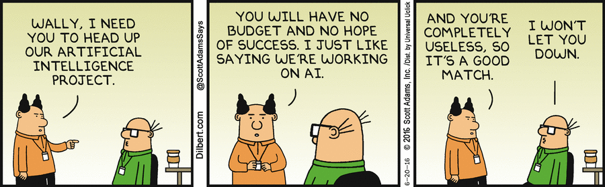
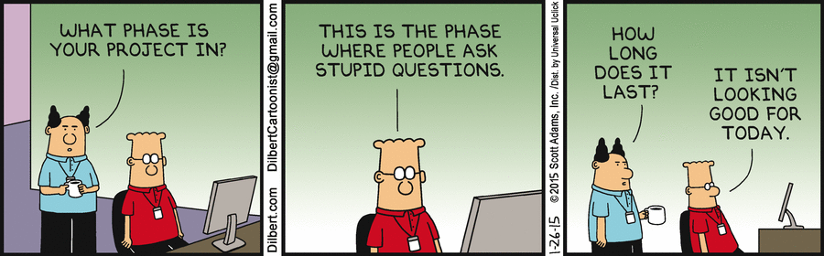
Notes:
https://dilbert.com/strip/2015-0

Slide 2
Mid-Term Video youTube location: https://youtu.be/IFbWWuRP-lE

Slide 3
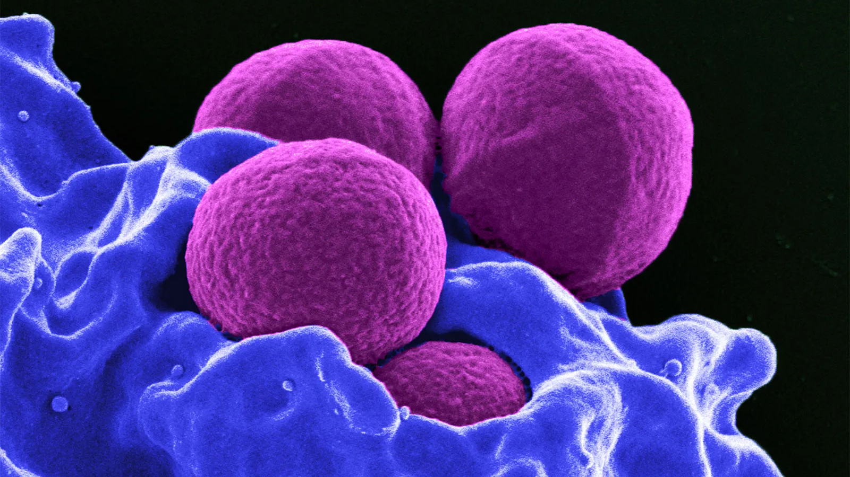
“Counting the Little Buggers” or Designing an A.I. that Inexpensively & Accurately Counts Blood Platelets
CS 3793 (Fall 2022) – A.I. Research Project Team 15 Members:
John Weaver
Brian van Vlymen
Chris Ayala
Notes:
https://www.britannica.com/science/white-blood-cell
MRSA and neutrophil
Four methicillin-resistant Staphylococcus aureus (MRSA) bacteria (purple) being engulfed by neutrophils (blue), which are a type of human white blood cell

Slide 4
The Topic:
Blood is life
Physicians need to analyze blood components
Hematology analyzers count & characterize blood cells
Basic analyzers:
Complete blood count (CBC)
3-part differential white blood cell (WBC) count
Sophisticated analyzers:
Measure cell morphology
Detect small cell populations
Diagnose rare blood conditions
Notes:
Blood is one of the most essential parts of the human body.
Hematology analyzers count & characterize blood cells for disease detection and monitoring.
Complete blood count is one of the most important diagnostic tools in medicine and one of the most common procedures.
can reveal important changes in the body and
is commonly used as the first stage in the process of evaluating patients’ health.

Slide 5
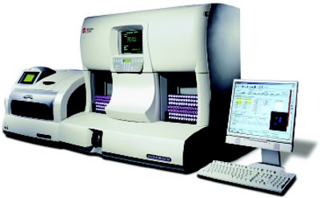
Top 3 Physical Technologies Used
Electrical impedance
Most common
Whole blood is passed between 2 electrodes
One cell at a time
The change in impedance is proportional to cell volume
Laser flow cytometry is
more expensive, but returns more detail
single-cell stream passes through a laser beam.
The absorbance & scattered light are measured at multiple angles
Fluorescent flow cytometry
Fluorescent reagents added
Used to measure specific cell populations
Notes:
$22,927 Additel
https://www.labcompare.com/10-Featured-Articles/162042-Hematology-Analyzers-From-Complete-Blood-Counts-to-Cell-Morphology/
Hematology analyzer technology
The three main physical technologies used in hematology analyzers are: electrical impedance, flow cytometry, and fluorescent flow cytometry. These are used in combination with chemical reagents that lyse or alter blood cells to extend the measurable parameters. For example, electrical impedance can differentiate red blood cells (RBCs), WBCs, and platelets by volume. Adding a nucleating agent that shrinks lymphocytes more than other WBCs makes it possible to differentiate lymphocytes by volume.
Electrical impedance
The traditional method for counting cells is electrical impedance, also known as the Coulter Principle. It is used in almost every hematology analyzer.
Whole blood is passed between two electrodes through an aperture so narrow that only one cell can pass through at a time. The impedance changes as a cell passes through. The change in impedance is proportional to cell volume, resulting in a cell count and measure of volume.
Impedance analysis returns CBCs and three-part WBC differentials (granulocytes, lymphocytes, and monocytes) but cannot distinguish between the similarly sized granular leukocytes: eosinophils, basophils, and neutrophils.
Counting rates of up to 10,000 cells per second can be achieved and a typical impedance analysis can be carried out in less than a minute.
Laser Flow cytometry
Laser flow cytometry is more expensive than impedance analysis, due to the requirement for expensive reagents, but returns detailed information about the morphology of blood cells. It is an excellent method for determining five-part WBC differentials.
A single-cell stream passes through a laser beam. The absorbance is measured, and the scattered light is measured at multiple angles to determine the cell’s granularity, diameter, and inner complexity. These are the same cell morphology characteristics that can be determined manually from a slide.
Fluorescent flow cytometry
Adding fluorescent reagents extends the use of flow cytometry to measure specific cell populations. Fluorescent dyes reveal the nucleus-plasma ratio of each stained cell. It is useful for the analysis of platelets, nucleated RBCs, and reticulocytes.

Slide 6
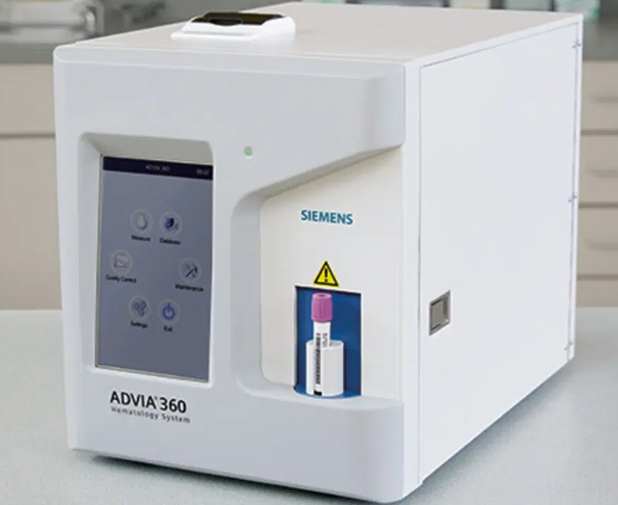
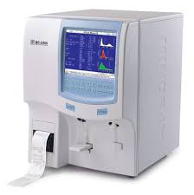
The Problem:
Cost
This ADVIA 360
$13,000
Others: $20,000 & up
Size
Weight
Complexity
Maintenance
Lack of portability
Notes:
Many hospitals, health centers, rural clinics, and small doctor’s offices still
use the old conventional method
which involves manual counting of blood cells.
This technique is time-consuming and
Error prone
Analyzers are $20k +
Too much for the small clinic or rural doctor to afford
3rd world nation can’t $$$
Power requirements
Portability
Ease of use
Training
Availability
Frequently cleaned and recalibrated.
Footprint vary small benchtop units to large automated machines.
16.9 in. × 14.2 in. × 14.2 in. and weighs only 30.9 lb.
The 801 model is 26 ft long × 4 ft deep and can analyze 120 slides/hr and 900 CBCs/hr.
https://www.siemens-healthineers.com/en-us/hematology/systems/advia-360-hematology-system
$13, 000
The ADVIA® 360 Hematology System offers low-volume and small-scale testing environments a fast and reliable hematology solution that fits within their budget. Whether used as a stand-alone system in a satellite laboratory or a backup for a primary hematology analyzer, the easy-to-use ADVIA 360 system’s convenient features help labs optimize and manage workflow.
Footprint
Systems vary from small benchtop units to large automated machines. The ABX Micros ES 60 from Horiba is a compact benchtop unit that delivers CBC + 3–diff. It has a touchscreen interface and can store 1000 patient results with histograms. It has a footprint of 16.9 in. × 14.2 in. × 14.2 in. and weighs only 30.9 lb.
The freestanding automated XN-9000 from Sysmex is scalable. The 801 model is 26 ft long × 4 ft deep and can analyze 120 slides/hr and 900 CBCs/hr. If linear floor space is limited, a corner unit can be added.

Slide 7
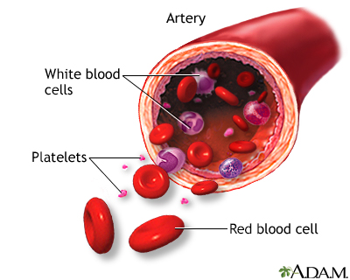
Red Blood Cells
Transport Oxygen & CO2
RBCs
White Blood Cells
Defense against infection
WBCs
Platelets
Blood vessel repair
Thrombocytes
Notes:
RBCs, also known as erythrocytes, are the most common blood cell type and are responsible primarily for carrying oxygen and carbon dioxide to the entire body. WBCs, also known as leukocytes, are the primary defense system against infectious disease and foreign invaders. WBCs are much less common than RBCs. For example, the number of WBCs in adult males ranges from 4.5 to 11.5 thousand in 1 microliter, where the number of RBCs in adult males ranges from 4.6 to 6 million in 1 microlitre [1]. Platelets, also known as thrombocytes, are non-nucleated entities and are 2 to 4 micrometers in diameter, and is responsible for repairing
blood vessels in case of injury.

Slide 8
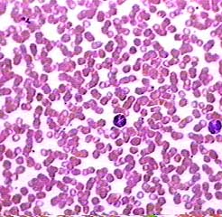
The Platelets are the small purple dots
400x Magnification
Notes:
400X Magnification
The red blood cells in this image are stacked on top of each other.
We included it to show you what an unacceptable smear looks like!
The Platelets are the small purple dots
https://www.austincc.edu/histologyhelp/tissues/tt_blood.html
The red blood cells in this image are stacked up on top of each other.
We included it to show you what an unacceptable smear looks like!
But it does have the advantage of including two kinds of white blood cell that are different from the one seen in the image above.
The leukocyte on the left has many very dark granules in its cytoplasm.
The granules are so dark that you can't see the nucleus.
The leukocyte on the right has a two-lobed nucleus and reddish-orange granules in its cytoplasm.
The thrombocytes, or platelets, do how show very well in these images.
You can see them if you look very carefully between the other cells. They will look like small purple dots.

Slide 9
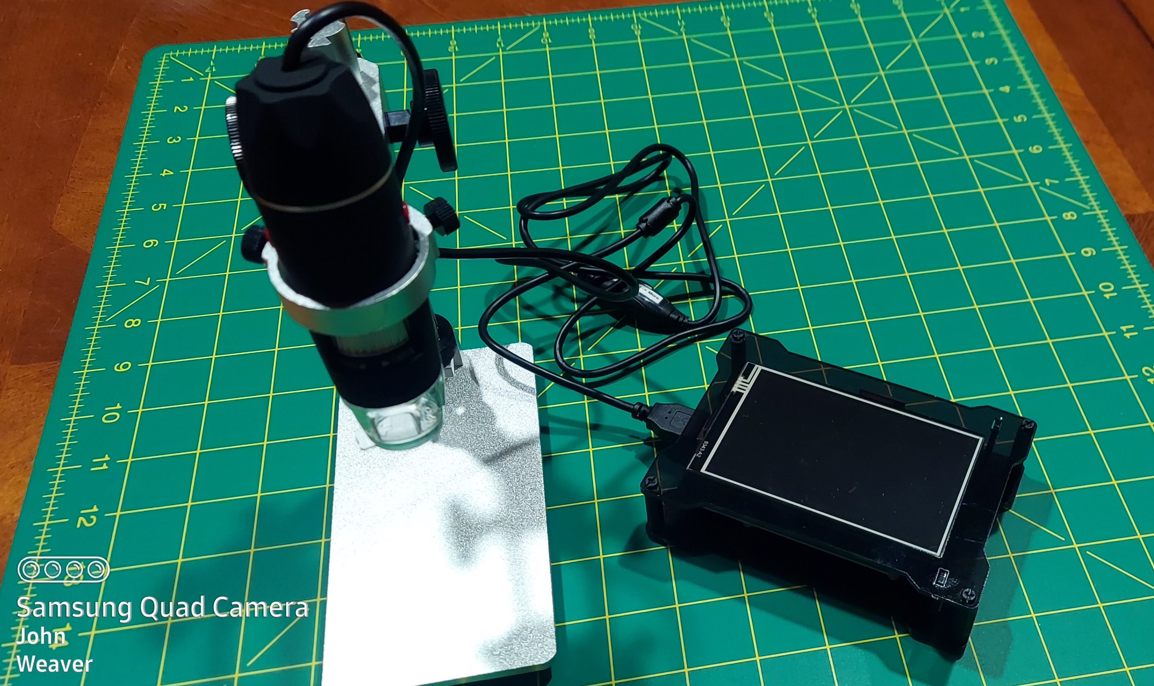
How about this setup instead?
40 – 1000x Magnification
Raspberry Pi 4
Touchscreen
Total Cost:
Not much
Notes:
Our idea: Why not use something like this.
Cost effective
Light weight
Portable
Low maintenance
40 – 1000x Magnification: $22
Raspberry Pi 4: $67
Touchscreen: $30
Total Cost: $120

Slide 10
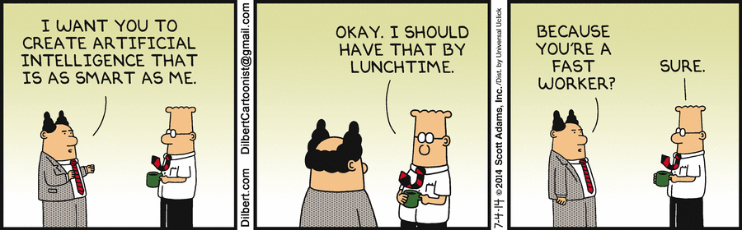
Our Thesis Statement:
Using readily available digital microscope (aka – inexpensive) design an A.I. to accurately identify and count various blood components and then return specific numbers and percentages for each category. Platelet count is our first priority, all other blood product components are secondary.
Notes:
Current machines cost $20,000 and up
Assumption: The slide is properly prepared by someone else for reading
Our project will read the slide to the appropriate medical standards / tolerances

Slide 11
Background Research - Overview
Chris Ayala:
“Automated RBC Morphology Counting And Grading Using Image Processing And Support
Vector Machine”
“A Review For Digital Microscope Using Raspberry PI”
“Accurate Microscopic Red Blood Cell Image Enhancement And Segmentation”
Brian van Vlymen:
“Computer Vision Approach for the detection of Thrombocytopenia from Microscopic Blood
Smear Images”
“Detection of WBC, RBC, and Platelets in Blood Samples using Deep Learning”
“Determination of Blood Components (WRCs, RBCs, and Platelets) Count in Microscopic
Images Using Image Processing and Analysis”
John Weaver:
“MAIScope: a low-cost portable microscope with built in vision AI to automate microscopic
diagnosis of diseases in remote rural settings”
“A Survey on Peripheral Blood Smear Analysis Using Deep Learning”
“Survey on Automatic RBC Detection and Counting”

Slide 12
“Automated RBC Morphology Counting And Grading Using Image Processing And Support Vector Machine”
Support vectors
Data points closest to the classification line
93% accuracy
Efficient
Cost effective
Fig 3. Raspberry Pi 4 Model B setup
Reviewed by Chris Ayala
Notes:
“Automated RBC Morphology Counting And Grading Using Image Processing And Support Vector Machine” (Pellegrino, Tarrobago, & Zulueta)
The method of using a SVM seems like one of the ideal paths to take.
A Support Vector Machine (SVM)
uses support vectors
data points closest to the classification line
to create a threshold on how data points are classified.
While the method is effective and useful, it’s
not as accurate as a human being analyzing the data,
but it is more efficient and cost-effective.
an automated system being used for an initial analysis, from there a doctor can choose to further analyze data if necessary.
Although with over 93% accuracy, I can see this system making life a lot easier for doctors, that way they can avoid analyzing unnecessary data.
“Automated RBC Morphology Counting And Grading Using Image Processing And Support Vector Machine” (Pellegrino, Tarrobago, & Zulue
The method of using a SVM seems like one of the ideal paths to take.
A Support Vector Machine uses support vectors (data points closest to the classification line) to create a threshold in which data points are classified.
While the method is effective and useful, it’s not as accurate as a human being analyzing the data, but it is more efficient and cost-effective.
A doctor may have more background information needed to make a particular diagnosis that a computer system would not be able to do.
I could see an automated system being used for an initial analysis, from there a doctor can choose to further analyze data if necessary.
Although with over 93% accuracy, I can see this system making life a lot easier for doctors, that way they can avoid analyzing unnecessary data.

Slide 13
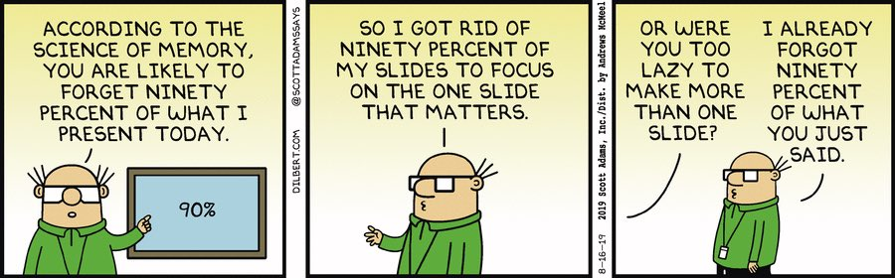
“Accurate Microscopic Red Blood Cell Image Enhancement And Segmentation”
Accuracy of a Person
Expertise of the person
Fatigue
Accuracy of a Model
Accuracy of the model
Slide prep prior to analysis
Reviewed by Chris Ayala
Notes:
The article makes a great point regarding the accuracy of a model vs the accuracy of a person.
It states the accuracy of manual methods depend
on the expertise of the expert, while the
accuracy of the automated analyzer depends on the accuracy of the model and its ability to segment objects.
Therefore if you think about it, once a near perfect model is developed,
- even though it may not be as accurate as the world’s top scientists,
- it may be more accurate than most scientists currently in practice.
The main issue right now is that blood samples typically contain overlapping cells,
which would need to be segmented prior to analysis,
thus producing a usable image that can be further analyzed by a computer.
“Accurate Microscopic Red Blood Cell Image Enhancement And Segmentation” (Shirazi, Umar, Ul Haq, Naz, Razzak)
The article makes a great point regarding the accuracy of a model vs the accuracy of a person.
It states the accuracy of manual methods depend on the expertise of the expert, while the accuracy of the automated analyzer depends on the accuracy of the model and its ability to segment objects.
Therefore, if you think about it, once a near perfect model is developed, even though it may not be as accurate as the world’s top scientists, it may be more accurate than most scientists currently in practice.
The main issue right now is that blood samples typically contain overlapping cells, which would need to be segmented prior to analysis, thus producing a usable image that can be further analyzed by a computer.

Slide 14
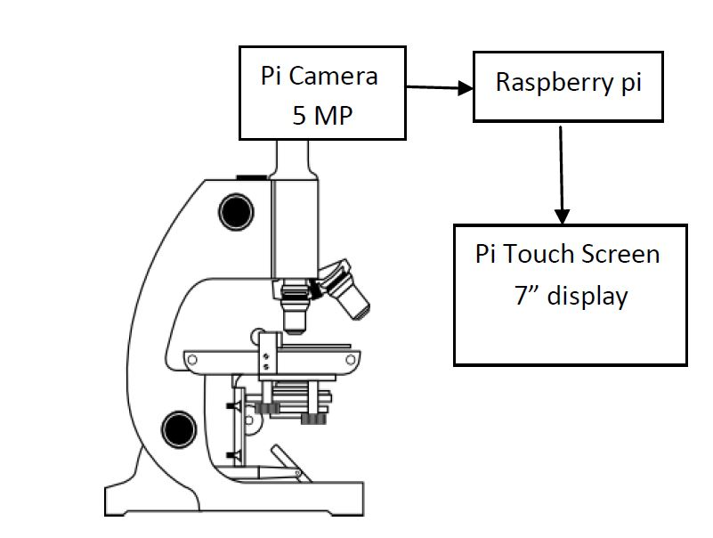
“A Review For Digital Microscope Using Raspberry Pi”
Digitizing a microscope
Raspberry pi 2 kit
5 MP Pi camera
7” Touchscreen
decrease the work of a biologist and
getting a better view of the sample
to demonstrate and examine the sample
Figure: 1.1: System Block Diagram
Reviewed by Chris Ayala
Notes:
A Raspberry Pi setup with a 5 MP Pi camera, a 7” Pi Touch Screen display, and a Raspberry Pi device would substantially
improve our ability to view and segment cells in a blood sample.
The digitization of the microscope using a Raspberry Pi setup would significantly
decrease the amount of resources, in various areas, required to perform an analysis on a blood sample.
ability to analyze a blood sample and
save it in a SD card
or send it to out to another lab via the internet within minutes
Instead of physically delivering the sample.
Power efficiency of a Raspberry pi compared to a regular PC
a Raspberry Pi setup only needs 5V of power.
Ability to magnify up to around 1500xx while
putting less strain on a person’s eyes,
the Raspberry Pi setup is clearly the optimal choice
“A REVIEW FOR DIGITAL MICROSCOPE USING RASPBERRY PI (KAUR & SINGH)”
A Raspberry Pi setup with a 5 MP Pi camera, a 7” Pi Touch Screen display, and a Raspberry Pi device would substantially improve our ability to view and segment cells in a blood sample. The digitization of the microscope using a Raspberry Pi setup would significantly decrease the amount of resources, in various areas, required to perform an analysis on a blood sample. For example, the ability to analyze a blood sample and save it in a SD card or send it to out to another lab via the internet within minutes would be a massive improvement over needing to physically deliver the sample. There’s also the efficiency of a Raspberry pi compared to a regular PC on a power consumption standpoint, a Raspberry Pi setup would only consume around 5V of power. With the ability to magnify up to around 1500xx while putting less strain on a person’s eyes, the Raspberry Pi setup is clearly the optimal choice

Slide 15
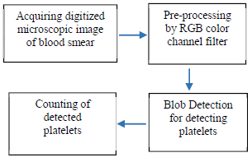
“Computer Vision Approach for the detection of Thrombocytopenia from Microscopic Blood Smear Images”
Thrombocytopenia
< 150,000 platelets / microliter
CBC = 1st line of detection
Blob Detection
Pi solution = 96% accuracy
Fig. 3: Block diagram of the computer vision approach for thrombocytopenia detection
Reviewed by Brian van Vlymen
Notes:
Thrombocytopenia is a reduced platelet count that
can cause a range of problems from
a little bit of gum bleeding to
severe hemorrhages or
even death
A CBC is the 1st step in detecting it, as well as other disease like Covid, Dengue Fever, and Leukemia.
This paper introduces an efficient & cost-effective computer vision technique known as blob detection
The technology uses digitized microscopic blood smear images to identify platelets as blobs
The algorithm was developed using a dataset of 50 digitized microscopic blood smear images.
The clinically estimated manual platelet count is considered as a reference.
The developed algorithm gives an accuracy of about 96.4% for the detection of platelets.
“Computer Vision Approach for the detection of Thrombocytopenia from Microscopic Blood Smear Images”
Human blood consists of three main cells, namely RBCs (erythrocytes), WBCs (leukocytes), and platelets (thrombocytes). The main function of platelets is the clotting of blood by forming a fibrous mass known as a thrombus, which builds a wall at the site of injury, stopping the flow of blood. Hence segmentation and identification of blood cells is very important diagnostic tools in medicine. Platelets, the smallest of our blood cells, can only be seen under a microscope. A normal platelet count ranges from 150,000 to 450,000 platelets per microliter of blood. Having more than 450,000 is called thrombocytosis while less than 150,000 is known as thrombocytopenia. The machine gets your platelet number from a routine blood test called a complete blood count (CBC). In common practice, delivering examinations in laboratories can be very difficult and location for the health centers cannot afford costly machines like Hematology Analyzer. Today many hospitals and health centers still use the old conventional method which involves manual counting of blood cells. This technique is time consuming. It's often analysis is prone to human errors. To make remedial health centers costly, an Android application developed with Raspberry-Pi of hardware and cost efficiency that can image analysis system detection for automatic platelet counting. Not only platelet detection and counting of RBCs, but WBCs have also been done with microscopic images. It shows that the proposed system has at least 90% accuracy of platelet. This is a model capable of automatically detecting cells in images with adequate accuracy. Detection of thrombocytopenia, leading to further medical analysis. This process of treatment of many diseases like anemia, leukemia, etc.

Slide 16
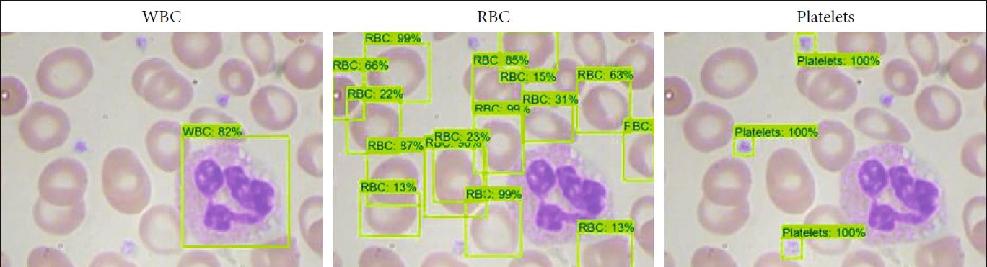
“Detection of WBC, RBC, and Platelets in Blood Samples using Deep Learning”
Used object detection libraries to train AI model
Adequate accuracy
RBC 89%
Platelets 96%
WBC 100% (with a caveat)
Figure 4: Interface of the prototype developed.
Reviewed by Brian van Vlymen
Notes:
This study is developing an alternative deep learning computational model
capable of automatically detecting cells in images of blood samples.
Using object detection libraries to train a model
that was focused on this task
Capable of detecting cells in images with adequate accuracy
When the identification of cells in images of blood samples
the best results obtained for accuracy
red cells accuracy of 89%
platelets accuracy of 96%,
it was possible to count white cells 100% accuracy
limits of the dataset provided prevented classifying the various types of WBCs
Author recommendation:
Since this study produced satisfactory results
It can be broadened to include further works that deal with classifying WBCs issue
“Detection of WBC, RBC, and Platelets in Blood Samples using Deep Learning”
We are not allowed a blood count missing to find the specific information that we are dependent diagnostic tools in medicine and it is one of the most common procedures. It can reveal important dataset and need to change in the body and it can be done in the first stage in the process of evaluating patients. Oftentimes health centers laboratories lack equipment due to expensive technology that requires frequent maintenance. However the new technology reveals a deep learning computational model capable of automatically detecting cells in images of blood samples. It helps to collect libraries so that they can train a model with adequate accuracy. Identification of cells accuracy about 96%.

Slide 17
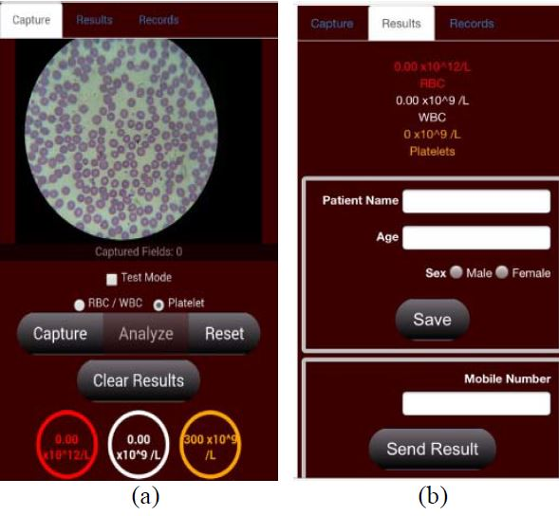
“Determination of Blood Components (WBCs, RBCs, and Platelets) Count in Microscopic Images Using Image Processing and Analysis”
PI based image analysis system:
HSV thresholding
Connected component labeling
Compared to actual CBC
90+% accuracy
Android App
Figure 9. GUI of the proposed system:
(a) Capture Tab, (b) Results Tab
Reviewed by Brian van Vlymen
Notes:
This paper presents a raspberry-pi based image analysis system that is designed to
Segment and count blood cells from microscopic images of blood
HSV = Hue, Saturation, and Value thresholding method
Connected component labeling,
Sample size = 10 patients - ten microscopic images.
Statistical analysis was performed to compare the values measured by the proposed system to the actual complete blood count test result of each patient.
proposed system has a 90% and up accuracy
Compared to actual CBC tests result.
Android App developed to aid the user:
especially those who are in rural areas,
in assessing the number of blood cells, and
Results from sent from the GUI
to a doctor or specialist
Via short message service (SMS)
for remote diagnosis
“Determination of Blood Components (WBCs, RBCs, and Platelets) Count in Microscopic Images Using Image Processing and Analysis”
Human blood cells are essential to our part of the body and consist of three main cells, namely RBCs (erythrocytes), WBCs (leukocytes), and platelets (thrombocytes). In common practice, delivering examinations in laboratories can be very difficult and location for the health centers cannot afford costly machines like Hematology Analyzer. Today many hospitals and health centers still use the old conventional method which involves manual counting of blood cells.
This technique is time consuming. It is often analysis is prone to human errors. The Raspberry-Pi bases image analysis stem that is designed to segment and count blood cells from microscopic images of blood. Also, this is applied to use Android applications to send the results from GUI to a doctor or specialist.

Slide 18
“MAIScope: A low-cost portable microscope with built-in vision AI to automate microscopic diagnosis of diseases in remote rural settings”
Malaria (2020 statistics)
627,000 deaths
241 million infected
Mass-AI-Scope (MAIScope)
Automate detection
Low cost
Portable
Embedded AI
Figure 1: MAIScope Hardware prototype with Case.
Reviewed by John Weaver
Notes:
According to the World Health Organization(WHO),
malaria is estimated to have killed 627,000 people and infected over 241 million people in 2020 alone,
a 12% increase from 2019.
Microscopic diagnosis of blood cells is the standard testing procedure to diagnose malaria.
Problems / Concerns:
this style of diagnosis is expensive, time-consuming, and greatly subjective to human error,
especially in developing nations that lack well-trained personnel to perform high-quality microscopy examinations.
This paper proposes Mass-AI-Scope (MAIScope):
a novel, low-cost, portable device that can take
microscopic images and automatically detect malaria parasites with embedded AI.
MAIScope: A low-cost portable microscope with built-in vision AI to automate microscopic diagnosis of diseases in remote rural settings
08/12/2022∙ by Rohan Sangameswaran, et al. https://deepai.org/publication/maiscope-a-low-cost-portable-microscope-with-built-in-vision-ai-to-automate-microscopic-diagnosis-of-diseases-in-remote-rural-settings
According to the World Health Organization(WHO), malaria is estimated to have killed 627,000 people and infected over 241 million people in 2020 alone, a 12% increase from 2019. Microscopic diagnosis of blood cells is the standard testing procedure to diagnose malaria. However, this style of diagnosis is expensive, time-consuming, and greatly subjective to human error, especially in developing nations that lack well-trained personnel to perform high-quality microscopy examinations. This paper proposes Mass-AI-Scope (MAIScope): a novel, low-cost, portable device that can take
microscopic images and automatically detect malaria parasites with embedded AI.

Slide 19
“A Survey on Peripheral Blood Smear Analysis Using Deep Learning”
Routine test performed:
Specialized medical laboratories
Specially trained technicians
Prone to human errors
Summarized:
Recent contributions
Main challenges
Promising future
Figure 1: Whole-slide images
Reviewed by John Weaver
Notes:
A Peripheral Blood Smears is the result of dispersing and staining a thin layer of blood on a microscope slide that is made of glass.
The authors acknowledge that it is typically difficult, even for experts, to categories some abnormal blood cells on the slide.
And analysis is prone to human errors
The author believes
using computer-based analysis will greatly enhance the process in terms of accuracy and cost.
Deep Learning neural networks have shown impressive performance in this context.
The Authors summarized:
Recent contributions
Identified the main challenges and
many areas are not tackled enough.
presented the recent contributions and discussed the promising future directions in the context of PBS analysis.
Peripheral Blood Smear (PBS) analysis is a routine test carried out in specialized medical laboratories by specialists to assess some aspects of health status that are measured and assessed through blood. PBS analysis is prone to human errors and the usage of computer-based analysis can greatly enhance this process in terms of accuracy and cost. Despite the challenges, Deep Learning neural networks have shown impressive performance in this context.
In this study the recent contributions are summarized along with the main challenges and future directions in this context

Slide 20
“Survey on Automatic RBC Detection and Counting”
A review of RBC detection & counting methods
An overview of previous computer vision algorithms
Basic six steps to image processing algorithms:
Rev
Reviewed by John Weaver
Notes:
Objectives:
study the different methodologies of RBC counting and
Identification of research directions
Blood cell segmentation & identification is very important as a health indicator.
The contents of the blood in particular the white blood cells, the red blood cells and platelets define the state of health.
Spent time discussing the specifics of blood production in the human body with multiple statistics.
The method of blood cell counting in a laboratory is done by using hemocytometer and microscope.
The authors believe this method can be inaccurate and unreliable completely dependent on physician skill.
It is also laborious and time consuming.
The authors looked at various image processing algorithms for counting blood cells.
Hough Transform based Methods
Thresholding Based Models
Watershed Transform Based models
Cell Structure and Intensity Based
Comparative Method
And identified six major steps:
image acquisition
preprocessing
image enhancement
image segmentation
feature extraction
counting algorithm
Image analysis can be more accurate, timely, and cost efficient as long as the sample is properly prepared.
They also believe that it is better than existing medical diagnosis techniques and have a few recommendations for future work:
Standardization of slide prep
Updating techniques
More research in the field of RBC counting
Blood cell segmentation and identification is very important as blood being health indicator.
A person’s health is determined using complete blood count.
The contents of the blood in particular the white blood cells, the red blood cells and platelets define the state of health.
RBC count is required. In laboratory, blood cell counting is done by using hemocytometer and microscope.
This method gives inaccurate and unreliable results that depend on physician skill. This task is laborious and time consuming.
The aim of this research is to produce a survey on computer vision system that can detect and estimate the number of red blood cells in the blood sample image using image processing algorithms.
This paper considers image processing for counting of blood cells. Image processing algorithms involve six major steps: image acquisition, preprocessing, image enhancement, image segmentation, feature extraction and counting algorithm.
The objective is to study the different methodologies of RBC counting and identification of research directions.

Slide 21
Trying to Solve the Problem
Identify research paper for further follow up
Define “Platelet Count”
What are the steps for doing a platelet count?
Identify the physical requirements (i.e. devices needed)
Include Current Readily Available Medical Device Cost
Identify the “true” requirements for COTS creation
Identify the A.I. concepts to utilize
Write the code to put it all together
Notes:
COTS = Commercial Off The Shelf
Six steps for image processing algorithms
image acquisition
preprocessing
image enhancement
image segmentation
feature extraction
counting algorithm

Slide 22
Counting the Little Buggers or Designing an A.I. to Inexpensively and Accurately Count Blood Platelets
CS 3793 (Fall 2022) – Artificial Intelligence Research Project Team 15 Members:
John Weaver
Brian van Vlymen
Chris Ayala
Notes:
https://www.britannica.com/science/white-blood-cell
MRSA and neutrophil
Four methicillin-resistant Staphylococcus aureus (MRSA) bacteria (purple) being engulfed by neutrophils (blue), which are a type of human white blood cell

Slide 23
Artificial Intelligence Sub-Fields
Level – 1 Topics
Computer Vision
Level – 2 Sub-field
Medical & Biological Vision
Level – 3 Sub-Topics
Object (cells, RBC, etc.) Counting
Platelet Counting

Slide 24
Intro the topic notes
Notes:
Intro the Topic.
What is the problem?
Explain the problem
Cost
Analyzers are $20k +
Too much for the small clinic or rural doctor to afford
3rd world nation can’t $$$
Power requirements
Portability
Ease of use
Training
Availability
Why is it difficult?
Why is it a problem right now?
Why is it important?
How is platelet counter important?
Why is platelet counter important?
Medical diagnosis
Medical treatment
Efficacy of treatment

Slide 25
Tasks to Complete:
Research to Complete:
Define “Platelet Count”
What is the accuracy & time standard to meet?
What are the steps for doing a platelet count?
Identify the device requirements (i.e. devices needed)
Include Current Readily Available Medical Device Cost
Capabilities
Initial Cost of Device
Cost per Test Performed
Identify the “true” requirements for a COTS solution
Identify A.I. concepts to utilize
Write the code to put it all together
Reformat & Finish PPT Slide Deck
Record & Submit Presentation

Slide 26
Raspberry Pi
Prices have been increased by the Raspberry Pi company. It doesn’t explain everything, but the official price for a Raspberry Pi has climbed up a bit. For example, a Raspberry Pi 4 with 2 GB is now $45 vs $35 in 2021.
Demand increased. The Raspberry Pi is becoming more and more popular, which is a good thing but also adds some tension to the supply chain. Resellers seeing this increase in sales can be tempted to increase their price (and that’s what they did).
Supply chain constraints. Following major events in the world (pandemic, war, etc.), the supply chain has been exposed to many challenges. And as for any “smart” devices, getting chips has become harder than ever.
Prices have been increased by the Raspberry Pi company. It doesn’t explain everything, but the official price for a Raspberry Pi has climbed up a bit. For example, a Raspberry Pi 4 with 2 GB is now $45 vs $35 in 2021.
Demand increased. The Raspberry Pi is becoming more and more popular, which is a good thing but also adds some tension to the supply chain. Resellers seeing this increase in sales can be tempted to increase their price (and that’s what they did).
Supply chain constraints. Following major events in the world (pandemic, war, etc.), the supply chain has been exposed to many challenges. And as for any “smart” devices, getting chips has become harder than ever.

Slide 27
Background Research requirements:
Briefly explain the 9 papers:
What papers did we find?
What other people have done to solve this problem
10 to 15 seconds
Don’t go into detail for each and every paper
Go over one paper in detail:
That is the next part of the research we are doing
May or may not have that part
But you can basically say this is one paper that you have figured out that you’re going to go into detail after this
Notes:
2. Background research
What papers did we find?
What other people have done to solve this problem
Briefly explain the 9 papers:
10 to 15 seconds
Don’t go into detail for each and every paper
What that paper is doing
We Can include an Image from that paper
This is what they are doing
This is what the other paper is doing
Go over one paper in detail:
That is the next part of the research we are doing
May or may not have that part
But you can basically say this is one paper that you have figured out that you’re going to go into detail after this
Or if you have already started doing it, you can explain it
If there’s a specific data set that you have that you are using across all of these, you can explain that
Stop Here for Mid – Term Presentation
For Final:
Go over one of those papers for each student and implement those papers.
And I say implement, I’ve already told this, it could just be finding the code and getting it to work on your computer.

Slide 28
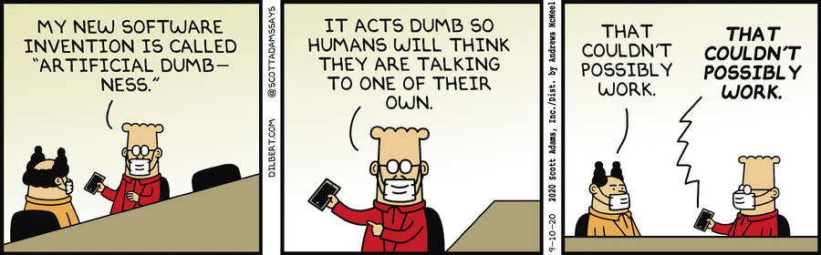
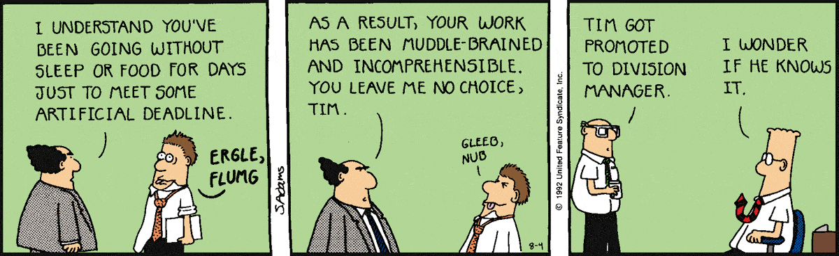

Slide 29
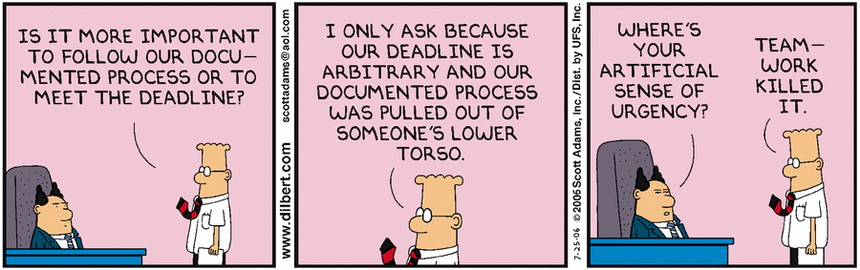
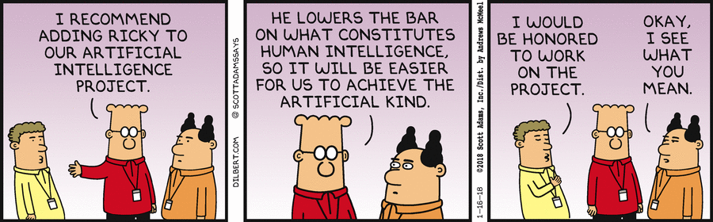

Slide 30
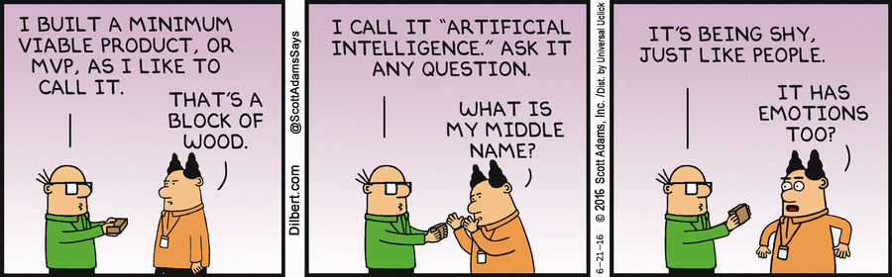
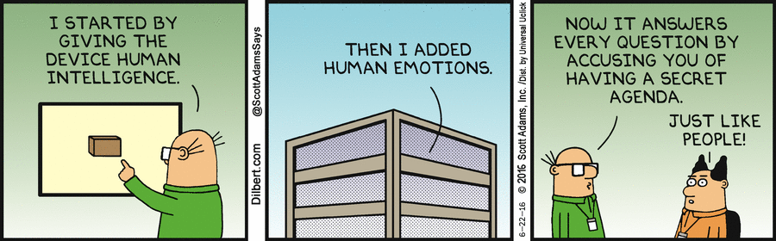

Slide 31
